Slide 1
Sencha Touch
Introduction to Mobile Web App development CA – T00172196- Chris O’Brien

Slide 2
What is Sencha Touch?
Sencha Touch is a JavaScript framework that was designed to be used by web developers who want to develop user interfaces that look and feel more like native applications whether it is viewed inside a browser or in a native wrapper.
Designed to help developers create HTML5 based apps that are cross platform.
Designed to create a web based standard framework.
First stable release was in November 2010 and current version is 2.1.3

Slide 3
Features
Sencha Touch offers many features such as the ability to package apps with Apache Cordova and Phonegap to wrap web apps in a native wrapper.
The framework has over 50 components built in such as smooth animations and supports many navigational views such as list views, grid views, tabbed views and many more.
The framework also boasts many themes that the user can pick from and use to make the application feel more native and users can also theme their apps as they see fit and are free to create their own.
Currently supports Android, IOS, Blackberry, kindle, Windows phone and Tizen mobile operating systems.
Supports touch gestures and touch events and once the app is put in a native container it has access to most of the devices sensors.

Slide 4
Limitations
5mb limit of local storage allowed unless the app is natively wrapped.
The framework itself has a high learning curve due to its class architecture system and MVC (Model-View-Container) methodology.
When the framework is updated it can sometimes break your app when trying to add new features.
Doesn’t support IE9 and under and opera’s mobile browser and there is no announced plan to support Firefox mobile OS
Touch gestures and touch events are only supported by Android and IOS as of Ver. 2.3.1 of Sencha Touch
There isn’t many 3rd party extensions like there are for many of the framework as Sencha Touch is not open source.

Slide 5
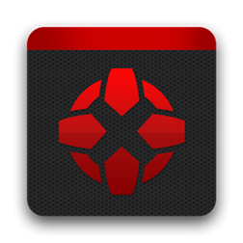
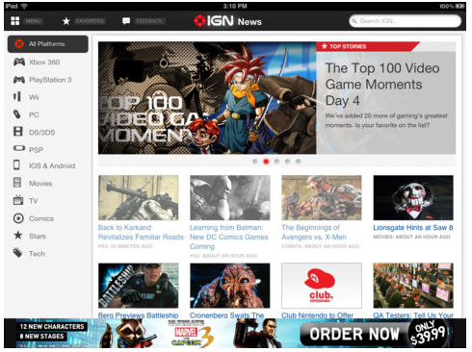
Examples of Apps built with Sencha Touch
IGN
(Website that reviews video games)

Slide 6


Examples of Apps built with Sencha Touch
Forbes Magazine
(Writes about business news and financial news)

Slide 7
Sencha Touch Vs jQuery Mobile
Sencha Touch has greater support for phonegap than jQuery mobile.
Sencha Touch has far greater support for touch guestures.
Sencha Touch is considered to be superior due its JavaScript MVC (model-view-controller) methodology, This makes allows multiple views of the same information possible.
Sencha Touch appears to have more GUI elements included than jQuerey Mobile

Slide 8
Why choose Sencha Touch?
Sencha touch appears to have more GUI components built in from the start.
It has better support for Apache Cordova and Phonegap than most frameworks and is perfect for hybrid apps.
I think the visuals of GUI components of the framework are far more visually appealing than jQuery mobiles.
Once you get past the high learning curve you can create far better Quality apps
The documentation is more organised and offers many code examples and visuial guides and Sencha Labs provide direct support and provides many tools to help with development such as Sencha Architect which allows users to make wire frames of their screens before development.

